Slide 1
How AI is Revolutionizing the Education

Slide 2


AI In Education

Slide 3

Personalize Education
Task Automation
Tutoring
Education For Students With Special Needs

Slide 4

Personalize Education

Slide 5

Personalize Education

Slide 6

Tutoring

Slide 7
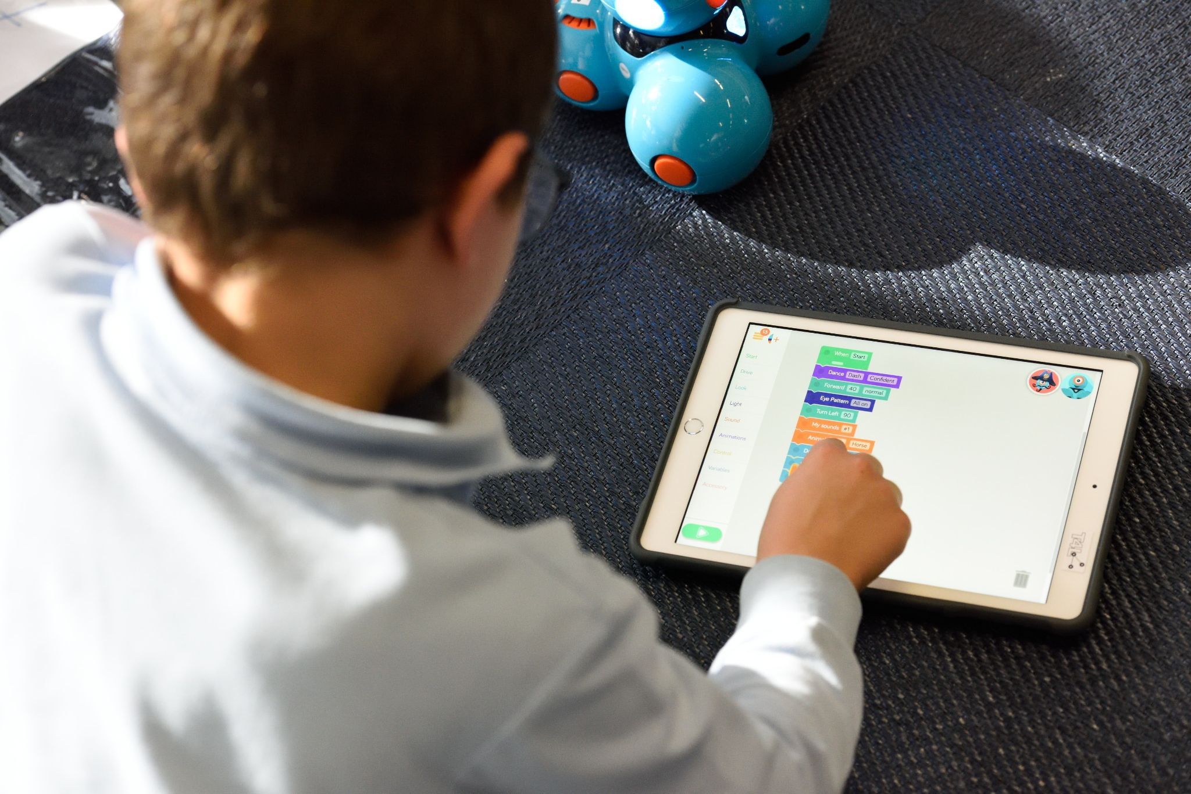
Education For Students With Special Needs

